Slide 1
Visual Question Ansering

Slide 2
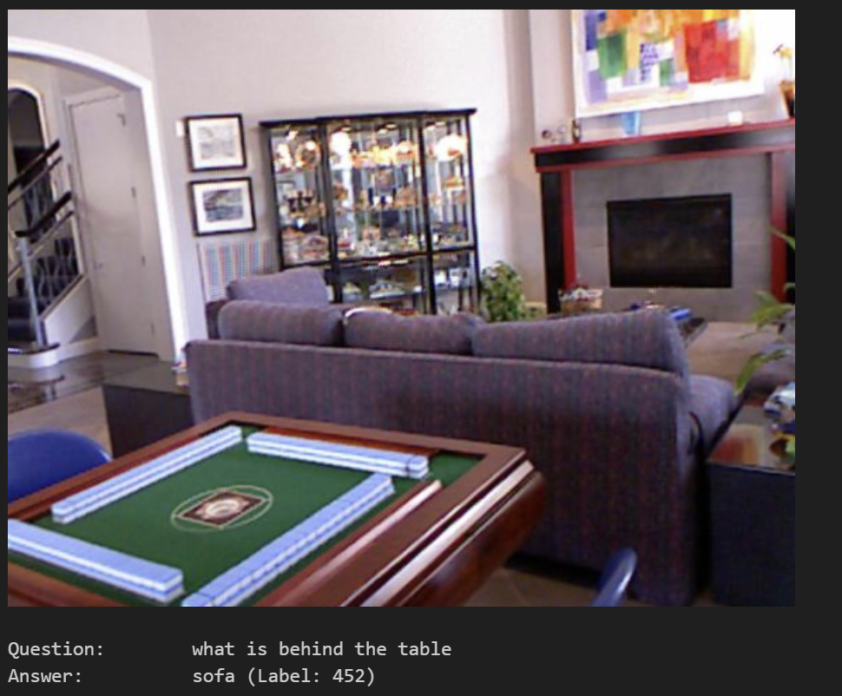
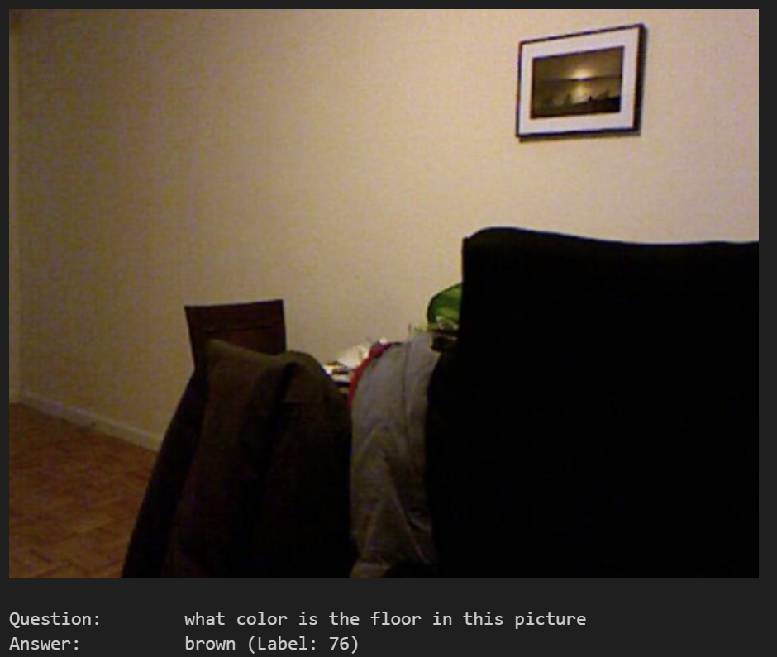
Task
Given an image and question about the image, choose answer from answer space. Answer space contains all possible answers.

Slide 3
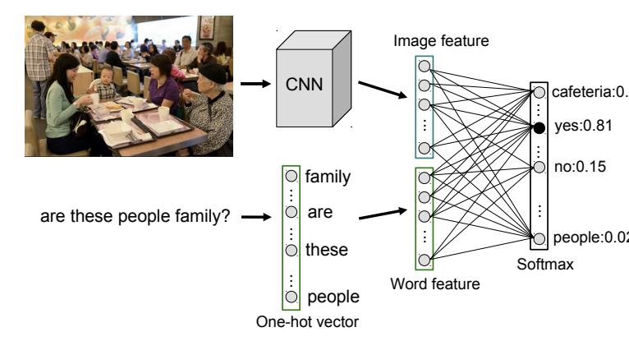
Baseline Models
Idea: extract embedding vector of question text and feature vector of image, concatenate them together and feed into a fc classifer for prediction.
Method 1: tokenizing the text and then learn the embedding vector via linear layer, image feature is extracted by some visual model (google net
Method 2: using pre-trained embedding vector from CLIP, and CLIP also comes with its own image feature extractor.

Slide 4
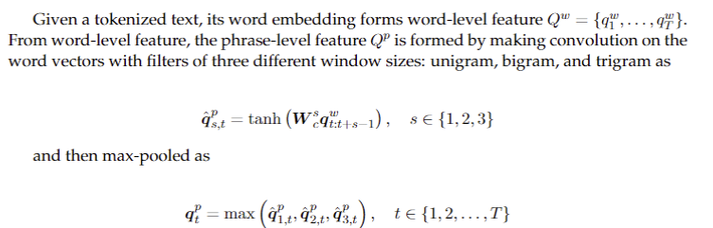
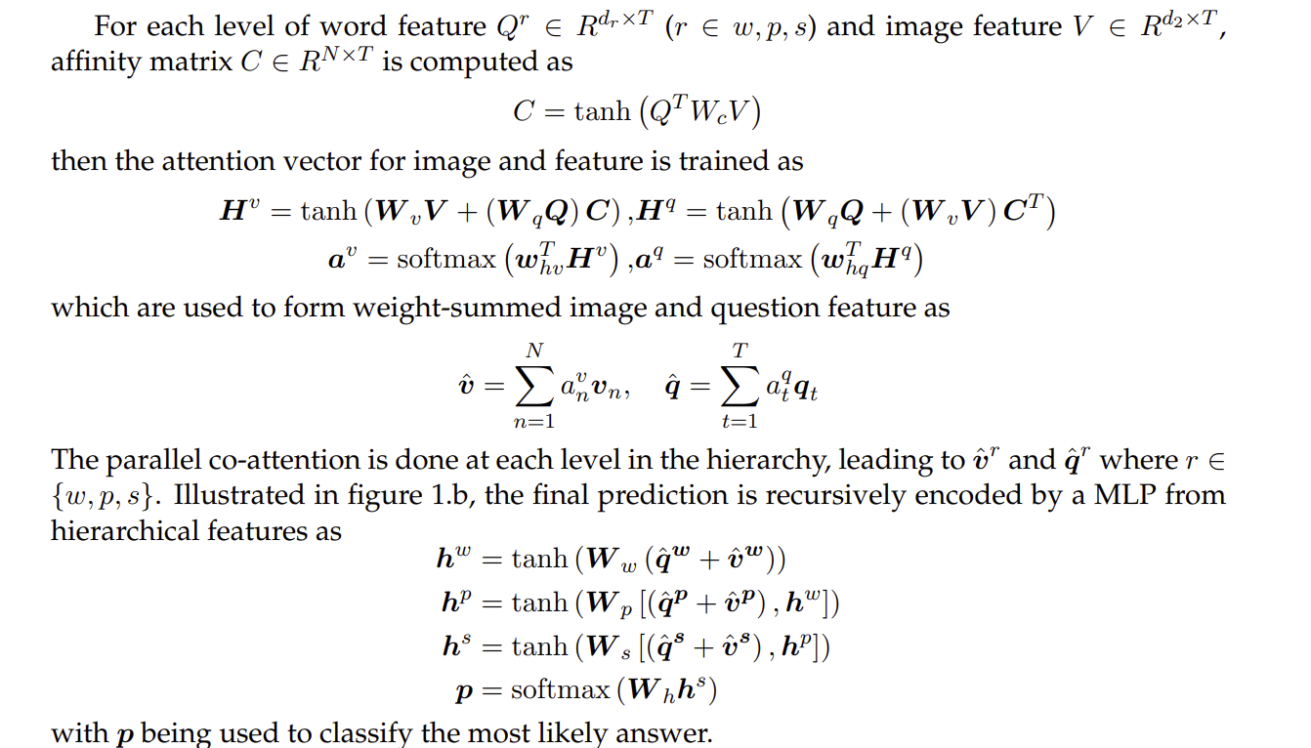
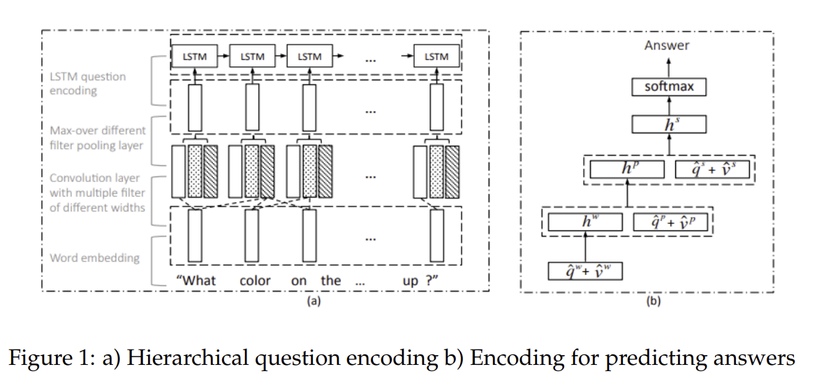
Hierarchical Co-attention

Slide 5
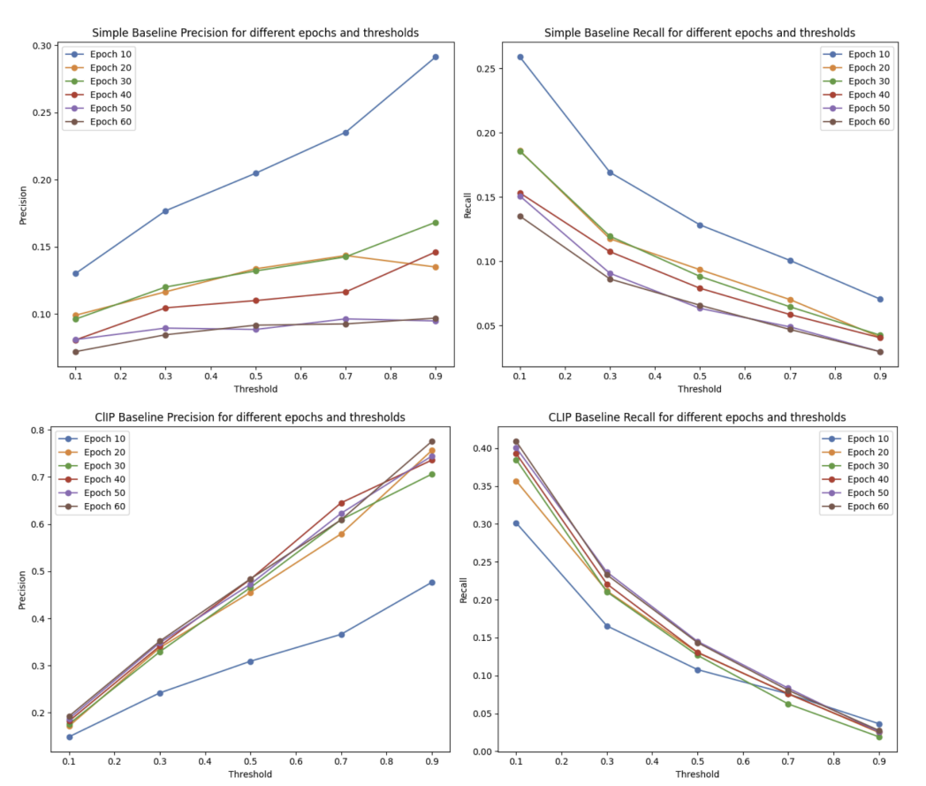
Result
For this vqa dataset with around 9000 training questions and 2400 testing questions, Co-attention model is beaten by simple baseline. In particular, CLIP baseline with robust text embedding is far better than simple baseline that learns embedding from the given dataset

Slide 6
Conclusion
These outcomes suggest that while attention mechanisms are intuitively appealing for VQA tasks, their practical efficacy may depend heavily on how the VQA problem is formulated. The classification approach to VQA, as demonstrated in this study, faces scalability challenges as the answer space expands.

